Slide 1

Macroeconomics of Foreign Direct Investment
Swagat Kishore Mishra
LECTURE 16

Slide 2
FDI : Wal-Mart, India and ROW
……For PoE

Slide 3
Introduction
World's largest retailer Wal-Mart Stores Inc is keen to open retail stores in India with the government allowing foreign investments in multi-brand segment.
The company, which currently operates a 50:50 joint venture with the Bharti Group for wholesale cash and carry, however, said it would have to study the policy fully and evaluate before finalizing its future course of action.

Slide 4
Wal-Mart India President Raj Jain
Currently, Wal-Mart's JV with Bharti Group -- Bharti Wal-Mart runs 17 Best Price Modern Wholesale stores in different parts of India. The JV is expected to open a total of 12-15 new such stores in India in 2012.
Bharti Wal-Mart is a major supplier to Bharti Retail, which runs over 205 retail stores in different formats under the 'easy-day' brand.
Jain said the policy change would allow the company to connect directly with the consumer and save them money.

Slide 5
News makers
Amid growing political opposition in India for easing of foreign investment norms in retail and other sectors, US-based companies like Wal-Mart and Prudential Financial are lobbying hard with their own lawmakers here to garner support for their Indian business expansion plans.
As per their latest lobbying disclosure reports filed with the House of Representatives and the Senate, the US-based companies and industry groups spent millions of dollars since the beginning of this year towards lobbying on issues including FDI in India, changes in Indian taxation framework and various other trade-related matters.

Slide 6
Wal-Mart and China
It is important to understand that there is a huge difference between the Chinese model and the Indian growth model, the Indian model is essentially domestic demand driven unlike the Chinese one that is fuelled by export growth.
More than 70 per cent of the commodities sold in Wal-Mart are made in China.
Wal-Mart Stores Inc, says its inventory of stock produced in China is expected to hit US$18 billion this year, keeping the annual growth rate of over 20 per cent consistent over two years.
"If Wal-Mart were an individual economy, it would rank as China's eighth-biggest trading partner, ahead of Russia, Australia and Canada," Xu Jun, Wal-Mart China's director of external affairs said.
Insiders point out that Wal-Mart's imports from China have largely influenced the US trade deficit in China, which is expected to reach US$150 billion this year.
According to Larry Mishel of the Economic Policy Institute about Wal-Mart's China policy, "A very conservative estimate could say that we (USA) have lost over a million jobs to China."

Slide 7
Wal-Mart and India
Wal-Mart is seeking to open its own retail chain throughout India. India's $250 billion retail business is the eighth largest in the world and has the potential to grow 7 per cent by 2011. [McKinsey Report] For a company already dominating the world markets, this is an un-passable opportunity.
The owners of Wal-Mart stand to gain enormous profits from this move while India’s economy will suffer and its workers will be subjugated to the unfair work practices of this Multinational Behemoth.

Slide 8
Crux of the Problem
In all of the countries Wal-Mart has set up shop it has put other retailers out of business and driven down wages.
Wal-Mart has a clearly defined anti-union policy aimed at preventing its work force from gaining any collective bargaining power which could result in increased wages, covered health benefits and job security.
Many reports have been written documenting the economic and eventual social and environmental degradation which occurs when Wal-Mart “comes to town”.

Slide 9
KEYNES Thought
Even apart from the instability due to speculation, there is the instability due to the characteristic of human nature that a large proportion of our positive activities depend on spontaneous optimism rather than mathematical expectations, whether moral or hedonistic or economic.
Most, probably, of our decisions to do something positive, the full consequences of which will be drawn out over many days to come, can only be taken as the result of animal spirits – a spontaneous urge to action rather than inaction, and not as the outcome of a weighted average of quantitative benefits multiplied by quantitative probabilities.

Slide 10

Chapter 13 suggests that animal spirits can be used to explain the persistence of poverty among ethnic minorities, describing how working class minorities have different stories about how the world works and their place in it, compared to working class white people. The authors argue that the effects of animal spirits make a strong case for affirmative action.
Animal Spirits: How Human Psychology Drives the Economy, and Why It Matters for Global Capitalism

Slide 11
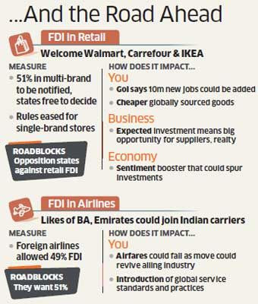
FDI :: Fit for Developing India ??

Slide 12
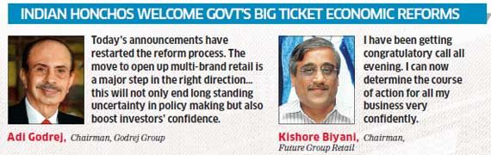
Global Indians say

Slide 13
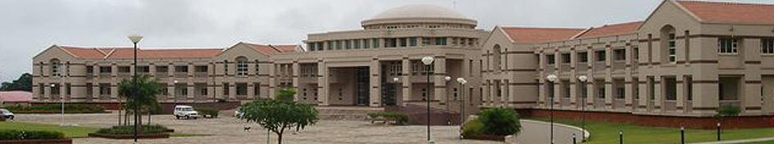
Thank you
Pupils of Economics

